Slide 1
Network Adequacy
Data Maintenance Planning
Round 2 of 2023
10:00 am-11:00 am Central
June 29, 2023
Regulatory Health Link Division,
Arkansas Insurance Dept., Dept. of Commerce

Slide 2
Agenda
Introductions & housekeeping
Overview of phases
Changes in the NA Regulation
CMS-CCIIO’s communications though PY2023 LTI and NBPP
Arkansas DOI’s position on the changes
Miscellaneous
PTNP process and dates
Errors to avoid
Best Practices/First time review
Appendix – Onboarding reference material

Slide 3
Introductions & Housekeeping

Slide 4
Introductions
Organization you represent & your name

Slide 5
Intended Audience-1
These meetings on Network Adequacy apply to all health and dental insurance carriers covered under Rule 106.

Slide 6
Intended Audience-2
AID attempts to communicate with three roles involved in Network Adequacy
NA Subject Matter Expert (NA SME).
Associated IT personnel.
Associated compliance personnel.
NA contacts known to AID are listed and grouped by organizations in Network Adequacy Industry Contact List.pdf on our NA website http://rhld.insurance.arkansas.gov/Default/NetworkAdequacy. Addition or removal of contacts in list can be emailed to RHLD.DataOversight@arkansas.gov

Slide 7
PTNP Data Maintenance
Why?
Industry agreement on the classification of individual providers and facilities, who treat Arkansans, into “Provider Types” defined by Arkansas.
This agreement is key to AID’s evidence-based Network Adequacy regulation.

Slide 8
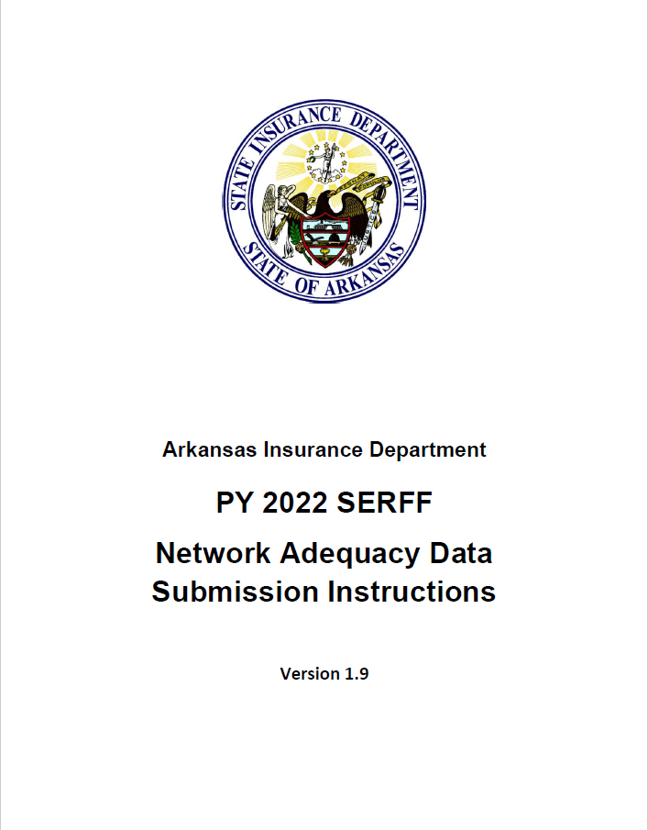
AR Specialty Access Template
(County Level-Provider Type Statistics Reported by Issuer)
ECP/NA Template
(Detailed Data. NPI & Practicing locations)
AR Provider-Enrollee Ratio Template
(State Level Provider-Enrollee ratios for various provider types)
Network ID Template
(Identifies unique networks used by issuer.)
AR Justification Template
(Justifications for shortcomings on county level statistics for different provider types)
Service Area Template
(Describes service area(s) covered by plans)
Various data templates used for Network Adequacy Regulation in Arkansas

Slide 9
AR Specialty Access Template
(County Level-Provider Type Statistics Reported by Issuer)
ECP/NA Template
(Detailed Data. NPI & Practicing locations)
AR Provider-Enrollee Ratio Template
(State Level Provider-Enrollee ratios for various provider types)
Network ID Template
(Identifies unique networks used by issuer.)
AR Justification Template
(Justifications for shortcomings on county level statistics for different provider types)
Service Area Template
(Describes service area(s) covered by plans)
A combination of Federal and Arkansas state maintained templates are used.
Various data templates used for Network Adequacy Regulation in Arkansas

Slide 10
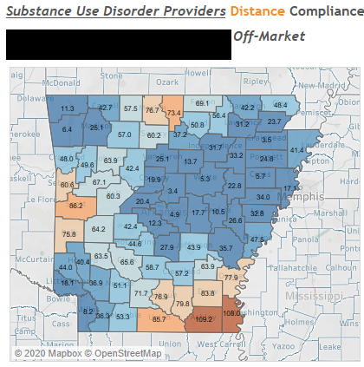
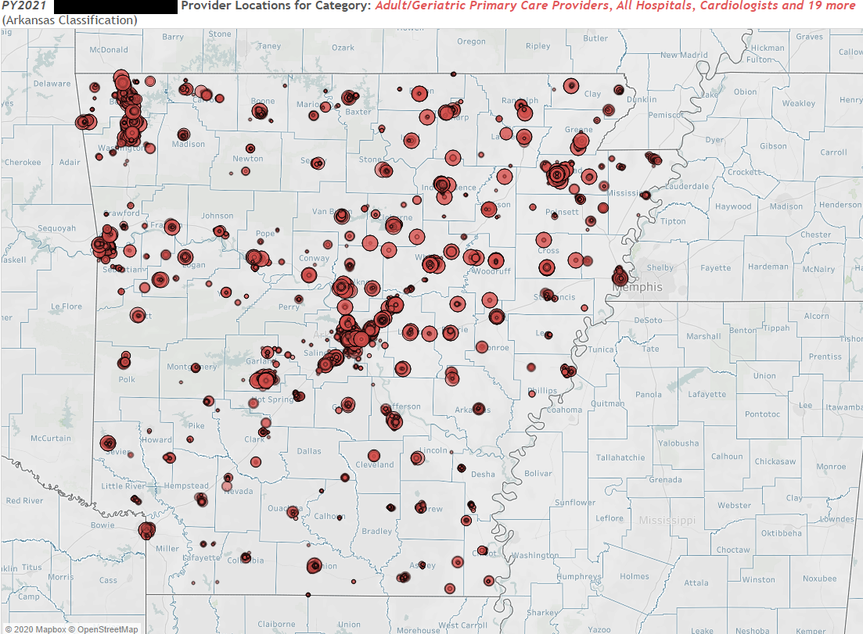
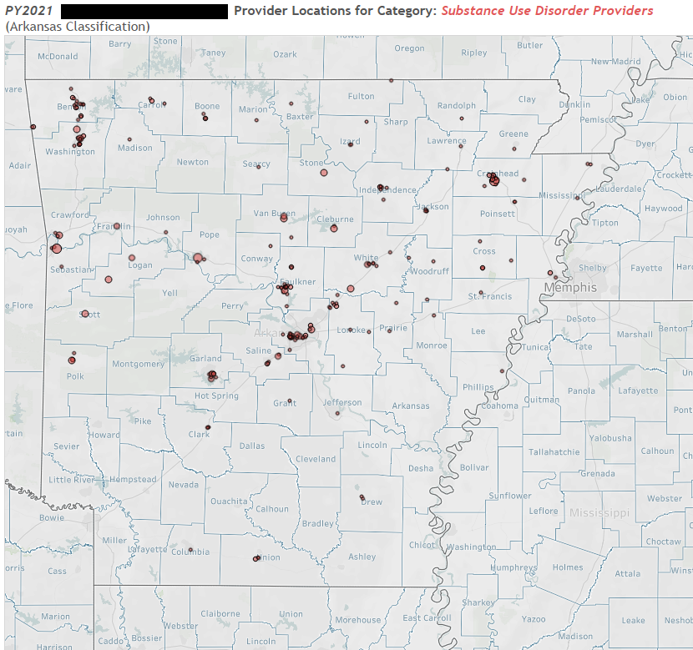
AR Specialty Access Template
(County Level-Provider Type Statistics Reported by Issuer)
ECP/NA Template
(Detailed Data. NPI & Practicing locations)
Example:
Review of Substance Use Disorder Providers
Current Finalized PTNP
(Industry agreed-to NPI classifications)
Filter by agreed classifications in the PTNP
Do these two tally?

Slide 11
AR Specialty Access Template
(County Level-Provider Type Statistics Reported by Issuer)
ECP/NA Template
(Detailed Data. NPI & Practicing locations)
Current Finalized PTNP
(Industry agreed-to NPI classifications)
Filter by agreed classifications in the PTNP
If not tallying, AID issues OBJECTIONS and any combination of these three templates could need a change
Do these two tally?
AR Justification Template
(Do use this to communicate actions
that will show up as future changes in the other templates)

Slide 12
AR Specialty Access Template
(County Level-Provider Type Statistics Reported by Issuer)
CORRECTION
ECP/NA Template
(Detailed Data. NPI & Practicing locations)
CORRECTION
CORRECTION
Current Finalized PTNP
(Industry agreed-to NPI classifications)
Case B: Unsupported claim?
Case A: Overly modest?
Filter by agreed classifications in the PTNP
Do these two tally?

Slide 13
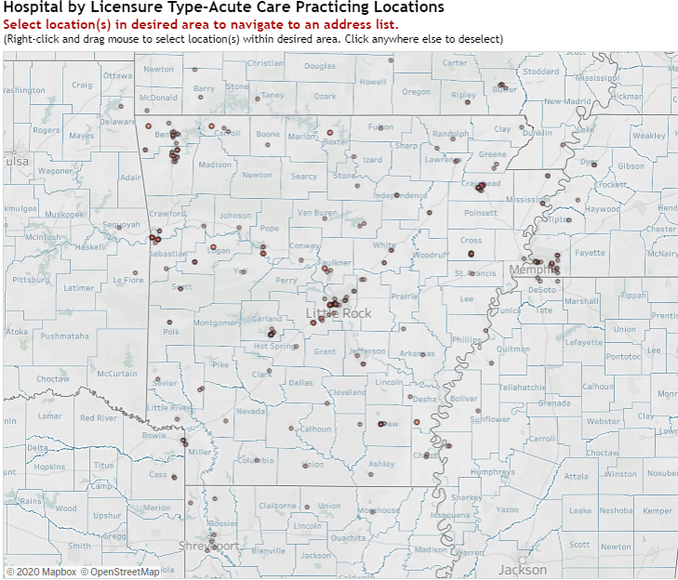
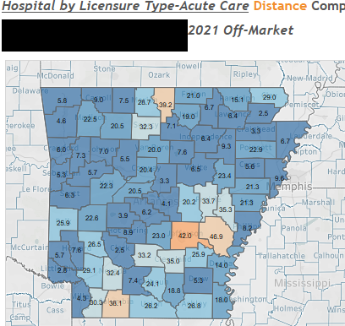
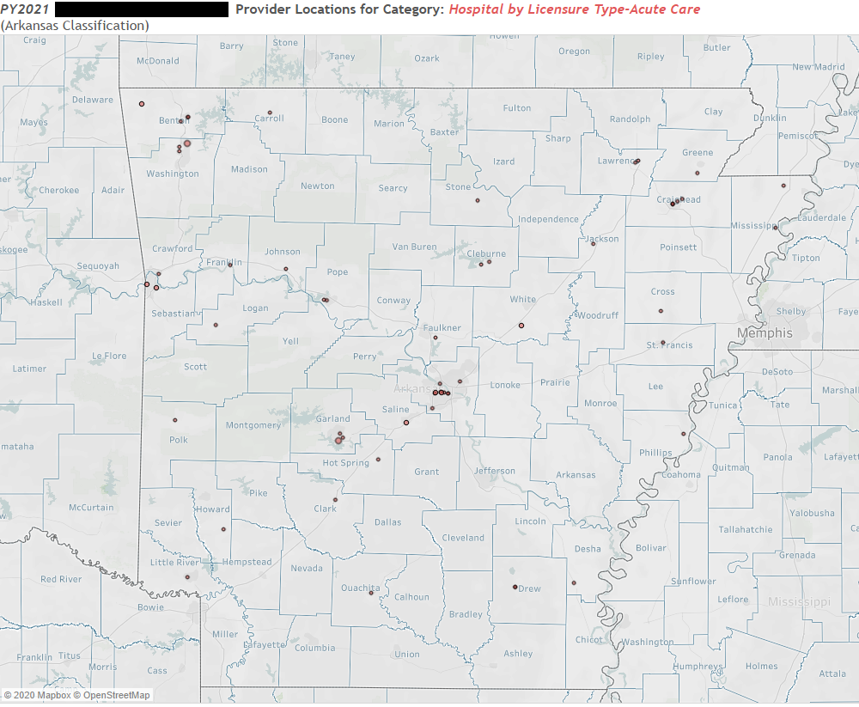
https://tinyurl.com/y6jg4wgr
Review of Acute Care Licensed Hospitals
Case C: Lacking contracts ?
Do these two tally?

Slide 14
Issuer actions expected for common objections.
Case A: Overly modest? The issuer has better access statistics than reported in the AR Specialty Access template. The issuer should take advantage of providers reported in the ECP/NA template but apparently ignored in the calculation of county access statistics for the counties referred to. They should make corrections as required and resubmit the AR Specialty Access template.
Case B: Unsupported claim? The average distance access statistics furnished in the AR Specialty Access template for the “provider type- County” combination is not supported by detailed data (provider NPI & practicing Address) in the ECP/NA template. In other words the statistic appears too rosy. There are two likely possibilities why this may have happened – A)The issuer has used providers within its network in its access calculations, who *do* exist in the PTNP, but have not been reported in the ECP/NA template – In that case the issuer has to update the ECP/NA template to include those providers and resubmit to AID -OR- B) The issuer has used some providers that do not exist in the PTNP – In that case the company will need to engage in the PTNP process and argue for their inclusion in the provider type category leading to the eventual change in PTNP, if their industry peers agree with the PTNP change.
Case C: Lacking contracts? Other issuers have providers in or around this county (may be in bordering state counties) who could be contracted with to improve network access. NPI, name and addresses can be obtained from the provider-type practicing location visualization created by using data aggregated from all issuers (refer https://tinyurl.com/y6jg4wgr). The company should determine if providers in or close to these areas are incorrectly classified and take either of two actions A) if they are determined to be incorrectly classified, the issuer should argue for their removal from the provider type classification through the next round of the PTNP process -OR- B) if the providers are determined to be correctly classified, the company should attempt to contract with the providers.

Slide 15
Overview of phases
Network Adequacy Review

Slide 16
Arkansas Network Adequacy Regulation Cycle
Plan Certification Data Submission
(SERFF)
Plan Certification Review
(SERFF)
Response to Objections
(SERFF)
PTNP Data Maintenance
(Round 2)
Continued NA Review
PTNP Data Maintenance
(Round1)
Start of cycle.
Two Types of Processes
Provider-Type-NPI-Pool (PTNP) data maintenance
NA data reporting and review
We are starting on this today.

Slide 17
Agenda
Introductions & housekeeping
Overview of phases
Changes in the NA Regulation
CMS-CCIIO’s communications though PY2023 LTI and NBPP
Arkansas DOI’s position on the changes
Miscellaneous
PTNP process and dates
Best Practices/First time review
Errors to avoid
Appendix – Onboarding reference material

Slide 18
CMS-CCIIO communications for PY2023 & 2024
1) Communications though PY2023 & 24 LTI and NBPP
Expects states to apply quantitative processes to ensure that
Federal Provider-Types are also monitored
Federal metrics are used
Federal thresholds are met.
(90% of enrollees are covered by a provider within the time and distance standards for the county)

Slide 19
Arkansas DOI’s position
Arkansas primarily uses “Average Distance to nearest Provider” which is different from CMS-CCIIO metrics.
Arkansas DOI is researching feasibility of the new metrics introduced by CMS-CCIIO for PY2023.
CMS-CCIIO metrics will not replace Arkansas primary metric (Avg. Distance) in the near future.
Arkansas DOI’s attempt to develop CMS-CCIIO metrics on time and distance does NOT anticipate additional data from the issuers.
Arkansas DOI will first apply CMS-CCIIO metrics to the marketplace issuers.
Arkansas DOI has not seen any initiative on provider data classification quality control in the CMS-CCIIO-States interactions so far. The state will therefore continue with its PTNP data maintenance process.

Slide 20
Miscellaneous changes
NPI Lookup is now a part of the PY<YYYY> Round <n> Initial Provider Type-NPI Pool template
Tracking responses to objections: Objection Reference ID introduced.

Slide 21
Agenda
Introductions & housekeeping
Overview of phases
Changes in the NA Regulation
CMS-CCIIO’s communications though PY2023 LTI and NBPP
Arkansas DOI’s position on the changes
Miscellaneous
PTNP process and dates
Best Practices/First time review
Errors to avoid
Appendix – Onboarding reference material

Slide 22
PTNP Maintenance Process Overview (Provider Classification Maintenance)
Two rounds a year (Round 1 & 2)
Each round has a two stage process
Stage 1: Suggestion for classification changes by industry
Stage 2: Voting on each change by industry
Agree
Dr. Marko is a Oncologist - not a Endocrinologist
Add NPI 56346449 as Pediatric PCP
Agree
Disagree
Add Dr. A Steel to OB/GYN
Provider Type Pool?
Dr. Smith has retired
Agree
Suggestions
Issuers
Insurance Dept.
Stage 2
Stage 1

Slide 23
PTNP data maintenance Round 1
Details available in NA Review Process.pdf
Expected: October 31, 2023
Finalized Provider Type-NPI Pool (Updated)
Done: Jun 20, 2023
AID Data Preparation
AID review and consolidation
Due: Sept 15, 2023
Initial Provider Type NPI Pool
Votes by individual carriers
Next up: Aug 2, 2023
Industry Review for changes
Industry vote on provider classification
Addition-Deletion Suggestions by individual carriers
Industry Provider Type Addition-Deletion suggestions
AID data consolidation
Expected: Aug 16, 2023
Stage 1
Stage 2

Slide 24
http://rhld.insurance.arkansas.gov/Default/NetworkAdequacy
2023 Round 2 Initial Provider Type-NPI Pool
(Available since June 20, 2023)
Add? Delete?
Blue Cross Experts
“20230116_83470_BCBS_Provider_Type_NPI_AddDelete.csv”
(Due August 2, 2023)
AID Secure FTP Server
Stage 1: “Suggestion for changes” stage using BCBS as an example

Slide 25
http://rhld.insurance.arkansas.gov/Default/NetworkAdequacy
"Industry Provider Type Addition-Deletion
suggestions" (Expected August 16, 2023)
To agree or not to agree on this addition and that removal?
Ambetter Experts
“20230315_80799_Ambetter_ObjectionVote.csv”
(Due September 15, 2023)
AID Secure FTP Server
Stage 2: “Voting” stage using Ambetter as an example

Slide 26
Expectations from Issuers
Refer pdf document NA Review Process located in http://rhld.insurance.arkansas.gov/Default/NetworkAdequacy (NA website)
Issuers provides suggestions for change. Due on January 16, 2023.
AID collects these suggestions and posts the consolidated information on NA website on August 2, 2023.
Issuers vote their agreement or opposition to suggested changes by others. Due on September 15, 2023.
AID processes votes and updates the PTNPs on NA website on October 31, 2023.
AID will use this updated PTNP data to review NA data submitted through SERFF for certification.

Slide 27
Agenda
Introductions & housekeeping
Overview of phases
Changes in the NA Regulation
CMS-CCIIO’s communications though PY2023 LTI and NBPP
Arkansas DOI’s position on the changes
Miscellaneous
PTNP process and dates
Best Practices/First time review
Errors to avoid
Appendix – Onboarding reference material

Slide 28
Best Practices/Reviewing for the first time?
Reviewing the entire list before the deadlines may not be feasible.
Suggest incorporating process triggers for revisiting the PTNP when
Objection is issued by Insurance Department for particular provider-type
New provider entering network
Belongs to a monitored provider-type but not in the PTNP?
Provider exiting network
Provider not serving Arkansans anymore (through other networks)?
Pay closer attention to the sparse provider-types
If you had no suggestions to add or delete during stage 1, consider reviewing others’ suggestions during stage 2 (vote on the changes suggested)
During Round 2 (and only in Round 2) of the PTNP Data Maintenance, within the template “<YYYY> Round 2 Initial Provider Type-NPI Pool Template”, there may be providers newly added and are flagged as such. They are added based on the fact that they were newly reported to AID for the annual review in SERFF, and their taxonomy in the NPPES NPI Registry matches one of the AID’s provider-types taxonomic definitions. These new provider classifications entries in the PTNP have *not* been vetted by the industry and at a minimum, these are the providers who need to be vetted for correct classification.

Slide 29
Agenda
Introductions & housekeeping
Overview of phases
Changes in the NA Regulation
CMS-CCIIO’s communications though PY2023 LTI and NBPP
Arkansas DOI’s position on the changes
Miscellaneous
PTNP process and dates
Best Practices/First time review
Errors to avoid
Appendix – Onboarding reference material

Slide 30
Errors to avoid (During “Suggestion for change” and “voting” stages)
PTNP Data Maintenance

Slide 31
Errors to avoid during Stage 1: “Suggestions for change” (1 of 3)
Please understand that PTNP data maintenance is NOT just about your network(s) alone. DO not attempt to remove a provider who is not in your network anymore but may work for others.
Please understand that our PTNP data maintenance attempts to focus on actual provider practice rather than academic qualifications. For example, a provider who is qualified in “Internal Medicine” but is known to work only in the ER of a hospital, should not be classified as a Primary Care Provider.
Please remember we are communicating about correcting classifications of NPIs (i.e. Providers). Not whether a NPI (i.e. Provider) exists. Each line communicates either addition of an NPI to a “C-bucket” –OR- removal of an NPI from a “C-bucket”.
A misclassified NPI *may* require two or more suggestions. One would be a removal from the incorrect “C-bucket” and if not already assigned to the applicable “C-bucket(s)”, addition(s) to the correct “C-bucket(s)”. Sometimes a misclassification may require only one suggestion- a removal from a “C-bucket” with no concomitant addition suggestions, since an appropriate “C-bucket” does not exist for the NPI.
Try not to approach the PTNP data maintenance with an inclination towards one type of action (say an inclination towards either addition or deletion). AID tends to compare competitor networks before issuing an objection. Just focusing on say additions and not on removal of inaccurate NPI classifications may not help you in AID’s comparative analysis. Please approach the PTNP data maintenance as an effort towards accurate classification.
While adding bordering state providers, please remember that AID does not have any “contiguous county” requirement. But bear in mind though that adding providers very far from the borders may not help with your average distance calculations. Add providers in bordering states that Arkansans do avail – because your consumers are probably the best judge.

Slide 32
Errors to avoid during Stage 1: “Suggestions for change” (2 of 3)
While removing a misclassification for a provider be careful not to remove other classification for the same NPI that may be correct.
For instance while cleaning up misclassified Endocrinologist NPIs, AID observed issuers removing correct association of those NPIs with Oncology.
While adding a NPI to a “C-bucket”, please pay heed to the taxonomic definition of the “C-bucket”. Same consideration applies when looking for removals.
For instance the current definition of C250 (Access to Dental – General) does not include Pediatric Dentists, so do not add them to “Dental General”. Conversely if you know an NPI listed in “Dental – General” is an Pediatric Dentist by practice, ask for its removal.
Do provide your most compelling reason for an addition or deletion. Each issuer’s reasons behind an addition or removal is shown to all issuers during the voting round and may influence their feedback. During vote processing AID may overrule the direction of a vote based on the strength of an issuer’s reason.
An example of a compelling reason for removal of a PCP can be a brief “Works only in emergency medicine in our 2016 claims data”.
Download and use the correct template to suggest changes. Please do not fashion your own spreadsheet.

Slide 33
Errors to avoid during Stage 1: “Suggestions for change” (3 of 3)
When a facility changes ownership, it gets a new NPI. When adding this NPI remember to delete the NPI associated with the previous owner.
Before adding an NPI to a provider bucket, ensure that the NPI does not already exist in that bucket.
Remember – we are doing this data maintenance because the NPI Registry does not have the adequate data quality for provider classifications. Therefore, do not be quick to re-classify a provider existing in the PTNP final list solely based on the taxonomy in the NPI Registry
Please understand that each Provider Type is defined as a collection of either individual providers or facilities. One provider type cannot represent both, facilities as well as individuals. For instance, do not attempt to add pharmacists to the Pharmacy Provider Type.

Slide 34
Errors to avoid during Stage 2: “Voting” stage (1 of 1)
Most network data considerations during the “add-remove” stage also apply to the “Voting” stage; Taxonomic definitions, Out-of-state provider distance considerations, etc. should be considered.
For example, before objecting to some other issuer’s removal of an apparently valid NPI-”C bucket” combination, consider if the provider is out of state, and if all practicing locations are far from the border.
Please use the recommended template.
Please remember that this stage is only to communicate your agreement or rejection of a suggested change of provider classification. It is not about communicating whether a NPI (i.e. Provider) exists – or – that the provider is miss-classified and should belong to a different bucket. While rejecting an addition suggestion, if you realize that the NPI belongs to a different C-bucket, your opportunity for suggesting the addition to the appropriate C-bucket(s) will be in future PTNP data maintenance rounds. Suggestion to add to a different C-bucket cannot be handled at this stage.
Do provide your most compelling reason behind rejecting an addition or deletion. AID may use the strength of your reason to settle a tie, or even reverse the direction of a vote.
An example of a compelling reason for rejecting addition of a NPI as a PCP can be a terse “Works only in emergency rooms per claims data”.

Slide 35
Next steps for industry
Refer to slide titled “Expectations from Issuers”
AID welcomes communication from Issuers on Network Adequacy on any issue
Clarifications or questions
One-on-one meetings for those new to the program
Suggestions for improvement

Slide 36
Questions?
Email
RHLD.DataOversight@arkansas.gov
Or call
Tonmoy Dasgupta (501-773-0420) Cell

Slide 37
Appendix
Reference slides for new issuer personnel

Slide 38
New to THE Program?
Arkansas Network Adequacy Regulation

Slide 39
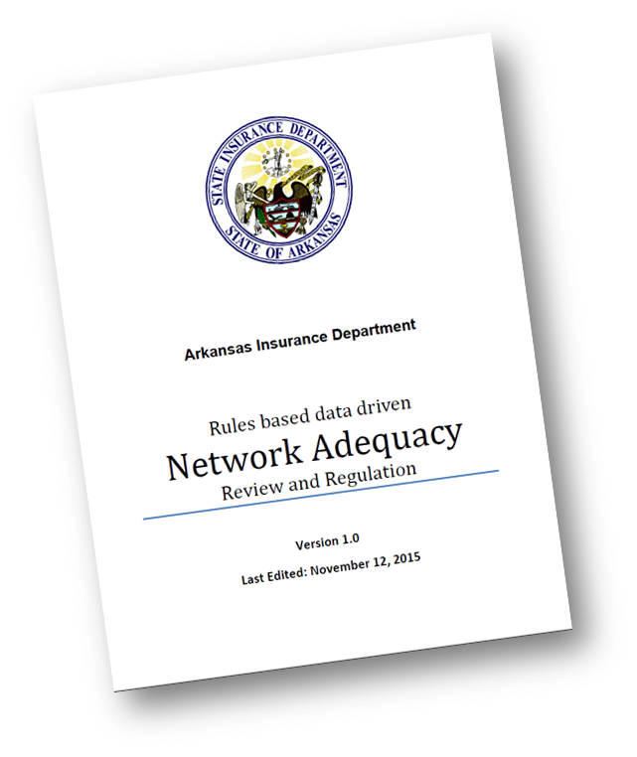
New to Arkansas NA Regulation Program?
Two important documents to read
Program details available at http://rhld.insurance.arkansas.gov/Default/NetworkAdequacy
“NA Review Process”
This document lays out NA activities for the coming plan year
Meeting slides and notes maintained in chronological order
Data specifications & templates updated at http://rhld.insurance.arkansas.gov/Info/Public/Templates
For data submission requirements refer “SERFF Network Adequacy Data Submission Instructions”
New issuers can call AID for an overview with Q&A.

Slide 40
Network Adequacy Overview
There are two major types of processes within the NA review in Arkansas.
Provider-Type-NPI-Pool (PTNP) data maintenance .
NA data reporting and review.

Slide 41
PTNP Data Maintenance versus NA Data Reporting & Review
PTNP Data Maintenance | NA Data Submission & Review in SERFF
Twice yearly | Once yearly
Regulatory data pre-planning. Not regulatory data by itself. | Regulatory Data.
Not mandatory. But is highly recommended because it has direct bearing on the regulatory data submitted (Arkansas templates) and on analysis done by AID (on Federal ECP/NA templates). | Mandatory.
SERFF not used for data interactions. Data exchanges through AID public website and Issuer data submissions to AID’s secure FTP server. | Only SERFF used.
Industry information drives outcomes. | Regulatory requirements drives outcomes.

Slide 42
How is data exchanged in the PTNP process?
From AID to issuers:
AID’s Network Adequacy (NA) webpage (http://rhld.insurance.arkansas.gov/Default/NetworkAdequacy)
For file names refer Network Adequacy Review Process.pdf located in the same webpage.
From issuers to AID:
Delivery to AID’s secure FTP servers following instructions in “General Data Submission Process to RHLD” located at http://rhld.insurance.arkansas.gov/Info/Public/Templates. For file naming conventions during the two stages of issuer feedback refer Network Adequacy Review Process.pdf located in AID’s NA webpage.
Data submissions from issuers explained with examples in later slides.

Slide 43
AID Disposition Details
AID provides detailed information on the outcome of the voting stage.
This makes available cases where AID had to
wade in to settle tie breakers OR
reverse a popular vote based on a strong(er) reason provided by the minority (few cases)

Slide 44
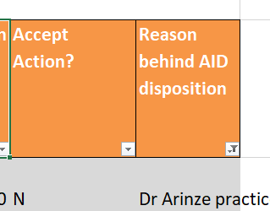
Initial Provider Type NPI pool template

